Slide 1
Fitts and GOMS
Scott Klemmer (sub: Anoop Sinha)
tas: Marcello Bastea-Forte, Joel Brandt,
Neil Patel, Leslie Wu, Mike Cammarano
09 October 2007

Slide 2
A little bit about this lecture
http://www.youtube.com/watch?v=p5cPVP_llfo#

Slide 3
A little bit about this lecture
Why is the Wii controller so much fun to use?
Minimizing the distance between our human capabilities and what we want to the computer to do

Slide 4
A little about myself – Anoop Sinha
Ph.D. ’03 UC Berkeley / B.S. ’96 Stanford
Group-mate with Scott
Did research on speech, pen, multimodal, multidevice user interfaces:
  Sinha’s Law: the number of electronic devices each person uses regularly increases on average by +1 every year
Worked in industry in Consulting and previously co-founded Danoo, which puts interactive digital screens in public places
aks@cs.stanford.edu

Slide 5
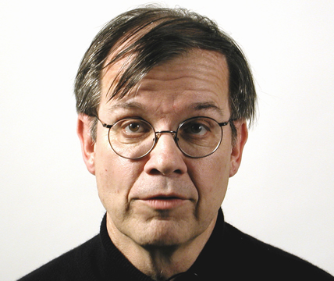
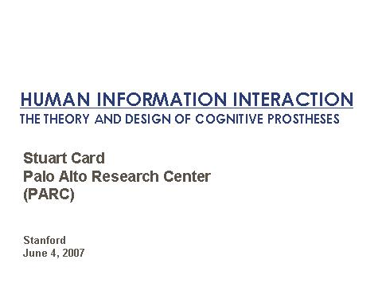
Material from Stu Card’s Lecture and James Landay’s Lecture
Stuart Card, Xerox, PARC
http://www.designinginteractions.com/interviews/StuCard
[Stu Card video from Moggridge Book]
Source: Moggridge, Bill. Designing Interactions. MIT Press, 2007

Slide 6

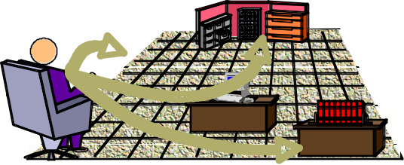
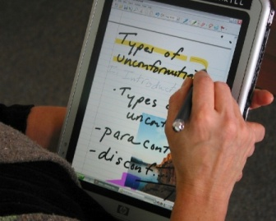
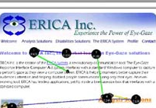
TIME SCALE OF BEHAVIOR
10⁷ (months) SOCIAL Social Behavior
10⁶ (weeks)
10⁵ (days)
10⁴ (hours) RATIONAL Adaptive Behavior
10³
10² (minutes)
10¹ COGNITIVE Immediate Behavior
10⁰ (seconds)
10⁻¹
10⁻² BIOLOGICAL
10⁻³ (msec)
10⁻⁴
Source: Card, Stu. Lecture on Human Information Interaction. Stanford, 2007.

Slide 7
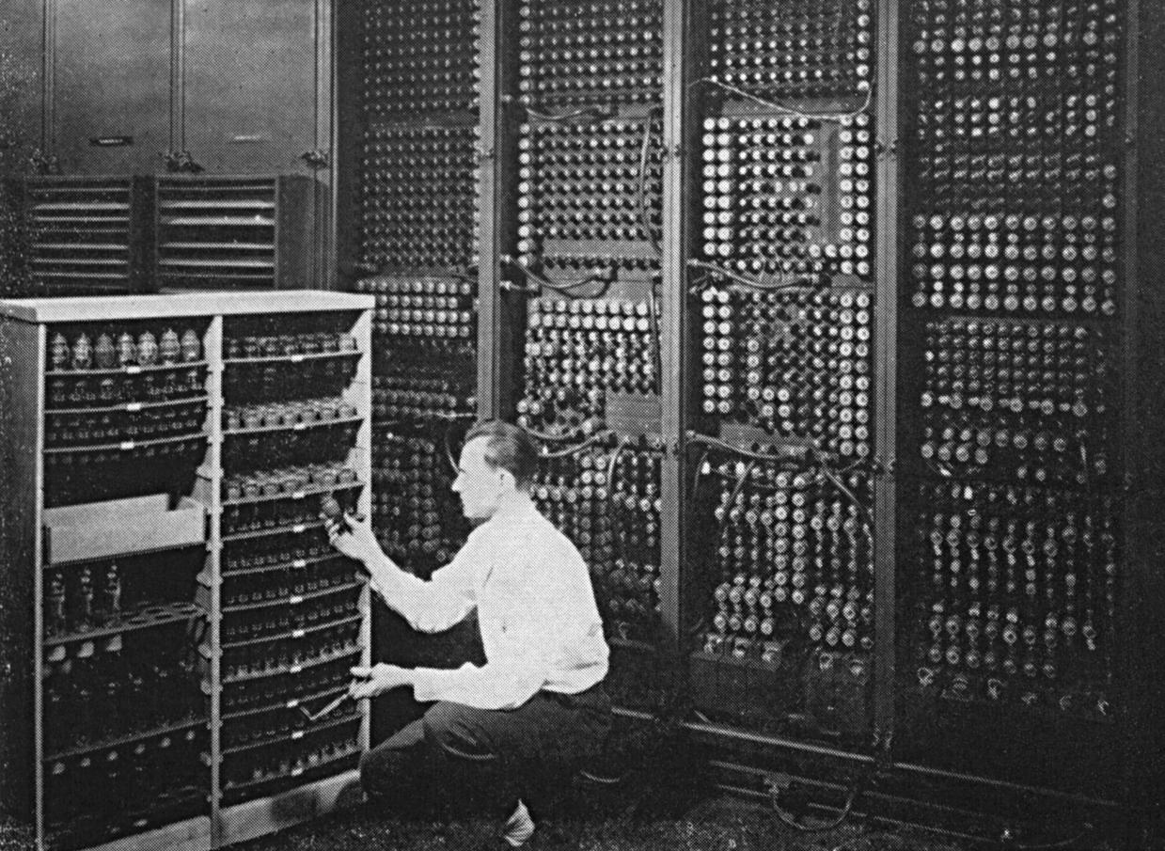
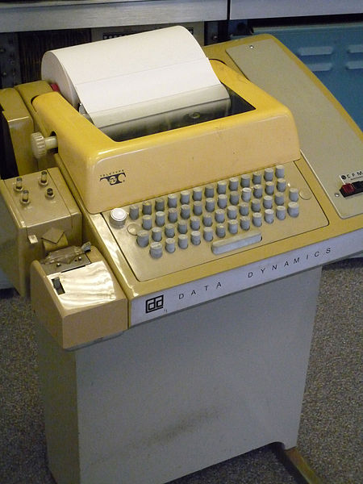
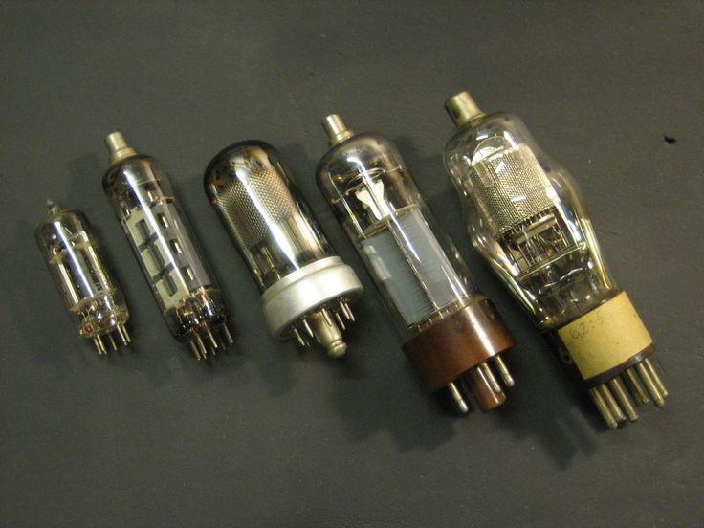
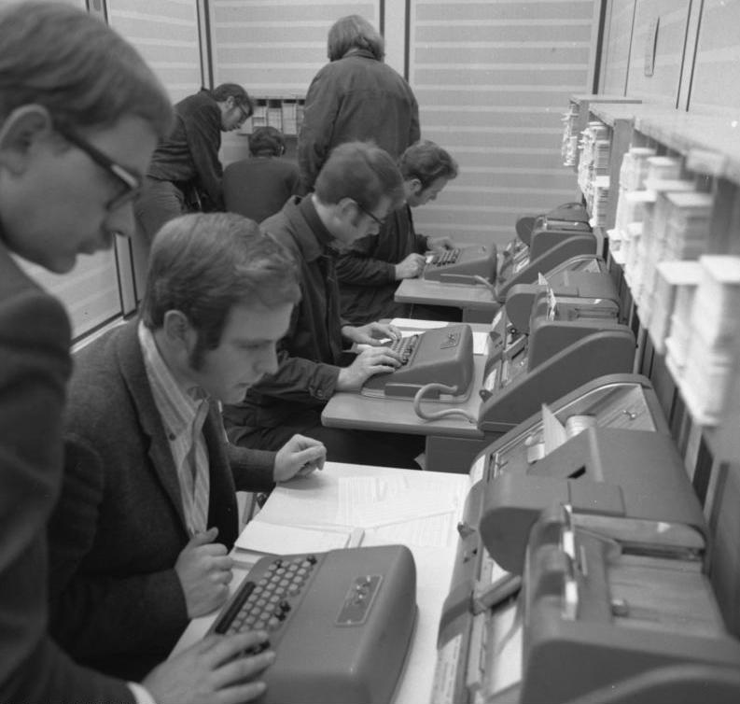
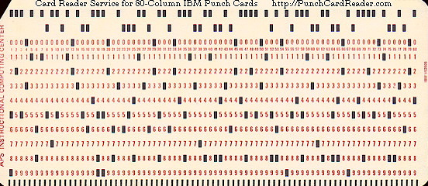
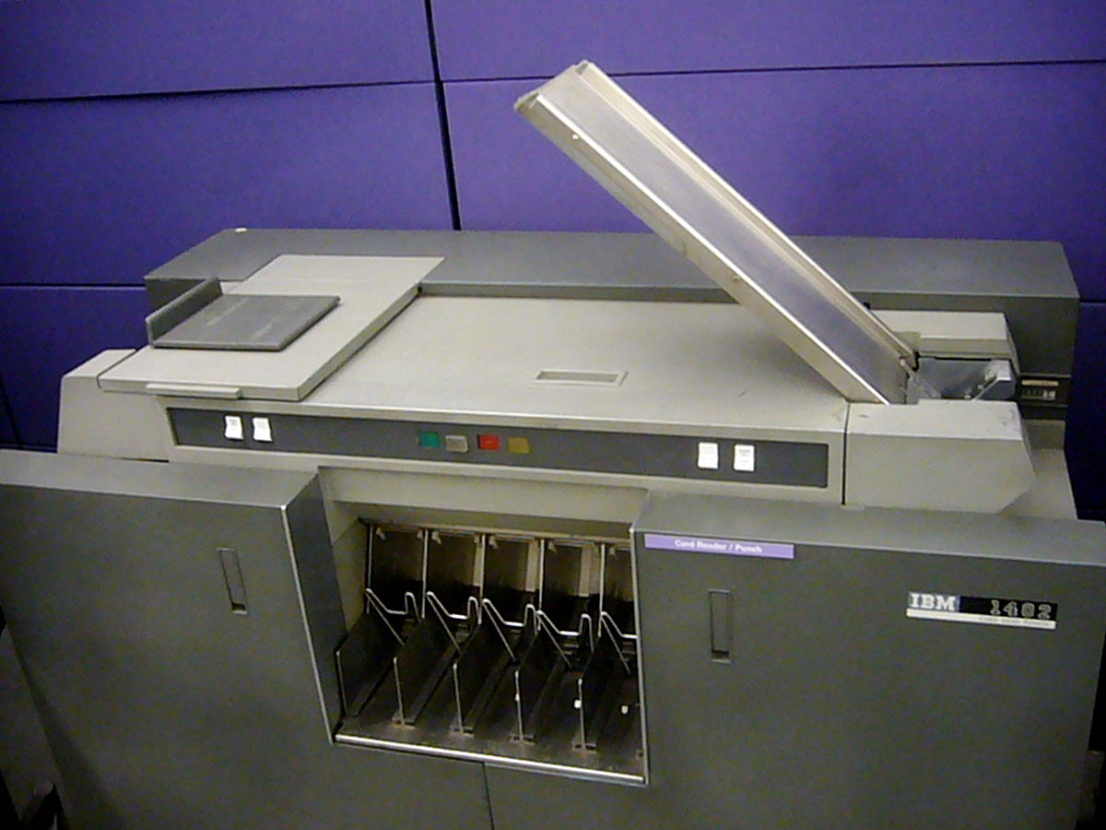
Ever wanted to have one?

Slide 8
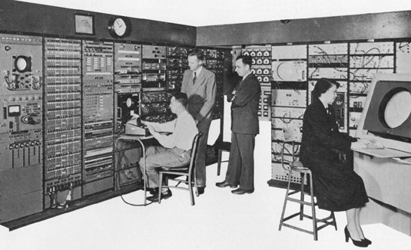
INTERACTIVE COMPUTING
typewriter I/O
Graphical CRT
Whirlwind (MIT-1951)
Source: Card, Stu. Lecture on Human Information Interaction. Stanford, 2007.

Slide 9
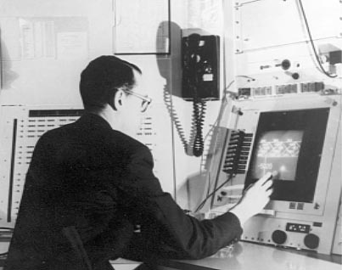
DIRECT MANIPULATION
Input on Output
Sketchpad (Sutherland, 1963)
Source: Card, Stu. Lecture on Human Information Interaction. Stanford, 2007.

Slide 10
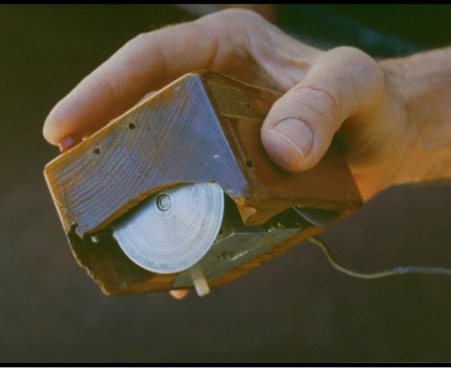
EXAMPLE: POINTING DEVICES
Mouse. Douglas Engelbart and Bill English (1964)
Source: Card, Stu. Lecture on Human Information Interaction. Stanford, 2007.

Slide 11
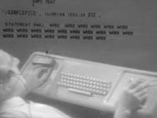
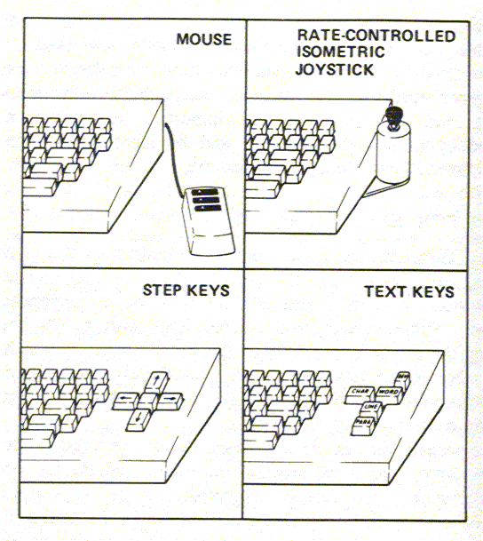
WHICH IS FASTEST?
Engelbart
Source: Card, Stu. Lecture on Human Information Interaction. Stanford, 2007.

Slide 12
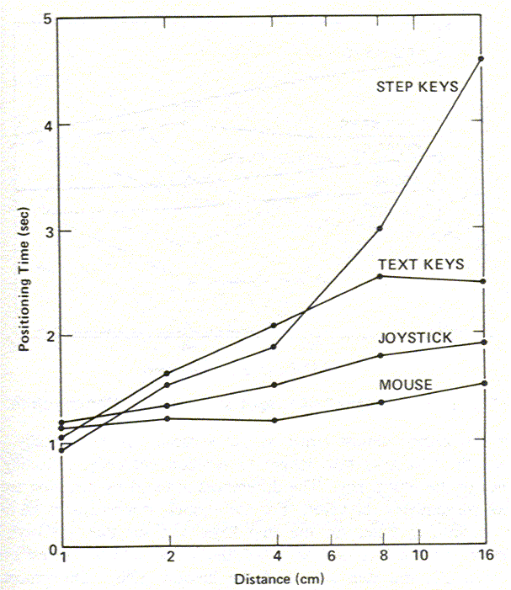
EXPERIMENT: MICE ARE FASTEST
Source: Card, Stu. Lecture on Human Information Interaction. Stanford, 2007.

Slide 13
WHY? (ENGINEERING ANALYSIS)
3
Why these results?
Time to position mouse proportional to Fitts’ Index of Difficulty I_{D}.
[i.e., how well can the muscles direct the input device]
Therefore, speed limit is in the eye-hand system, not the mouse.
Therefore, mouse is a near optimal device.
Mouse
2
Movement Time (sec)
1
T = 1.03 + .096 log₂ (D/S + 1) sec
0
1
2
3
4
5
6
I_{D}=log (Dist/Size + 1)
2
Source: Card, Stu. Lecture on Human Information Interaction. Stanford, 2007.

Slide 14
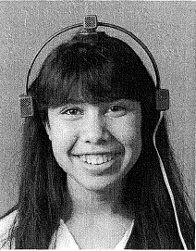
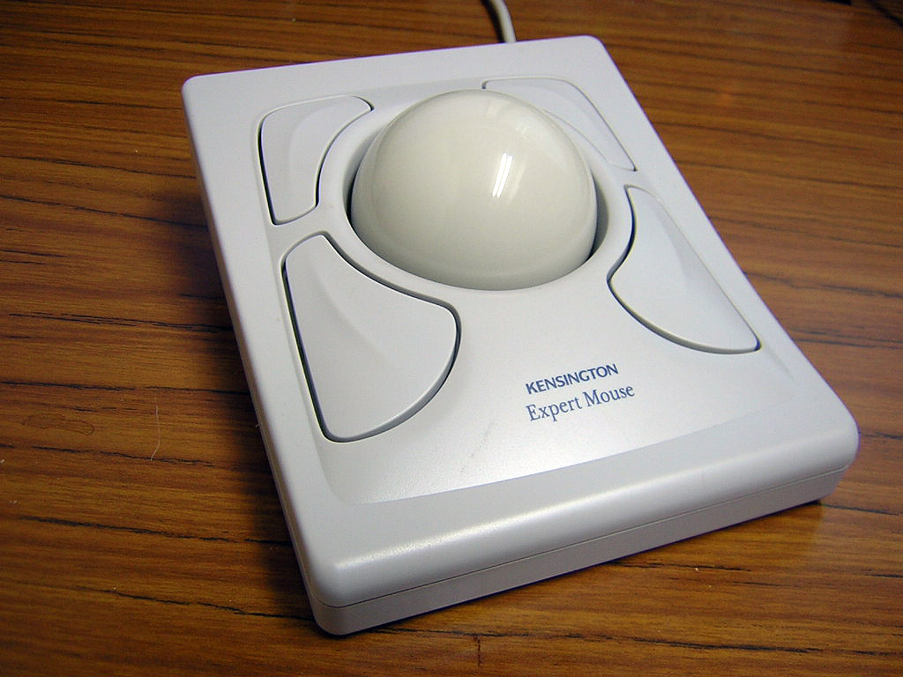
EXAMPLE: ALTERNATIVE DEVICES
Headmouse: No chance to win
Source: Card, Stu. Lecture on Human Information Interaction. Stanford, 2007.

Slide 15
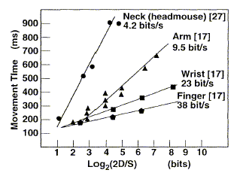
PERFORMANCE OF HEADMOUSE
Source: Card, Stu. Lecture on Human Information Interaction. Stanford, 2007.

Slide 16
Principles of Operation
Fitts’ Law
  Time T_{pos} to move the hand to target size W which is distance D away is given by:
    T_{pos} = a + b log₂ (D/W + 1)
a and b are constants that depend on the choice of input device and are usually determined empirically by regression analysis. a defines the intersection on the y axis and is often interpreted as a delay. The b parameter is a slope and describes an acceleration. Both parameters show the linear dependency in Fitts's law.
  summary
    time to move the hand depends only on the relative precision required
Source: Landay, James. “Human Abilities”. CS160 UC Berkeley.

Slide 17
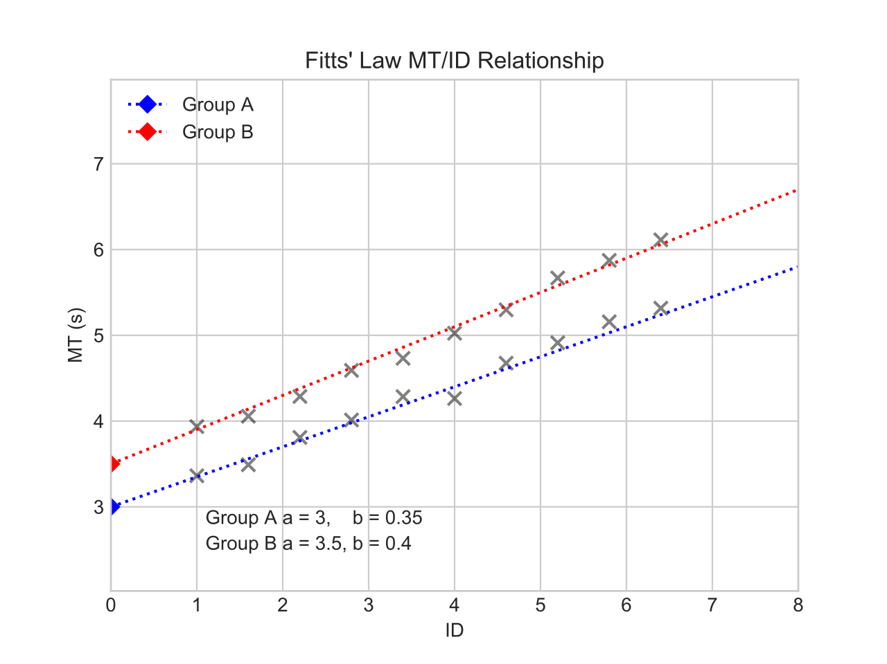
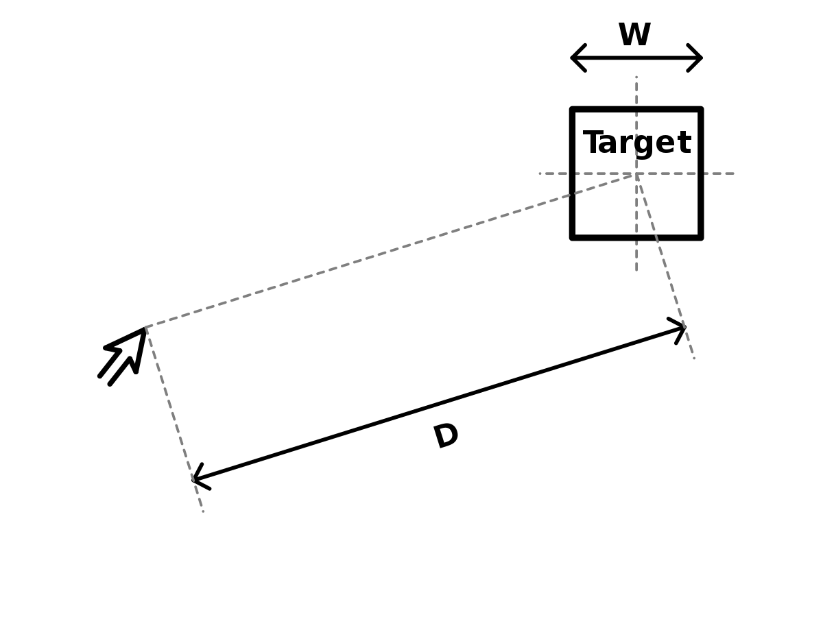
Fitts’ Law: a, b determination

Slide 18
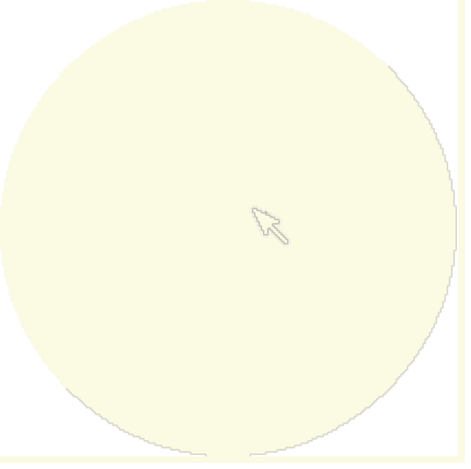
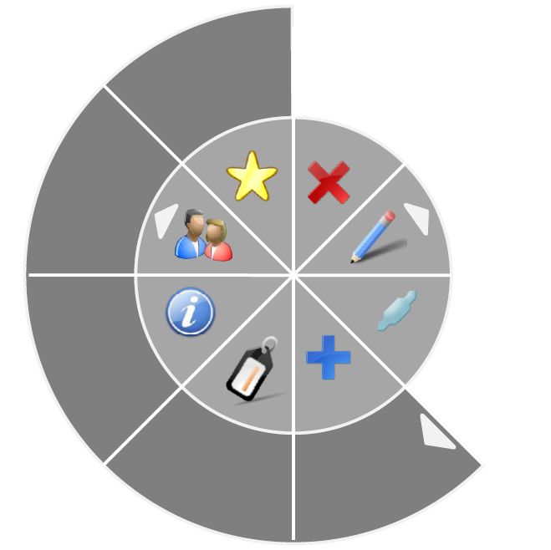
Fitts’ Law Example
Pop-up Linear Menu
Pop-up Pie Menu
Today
Sunday
Monday
Tuesday
Wednesday
Thursday
Friday
Saturday
Which will be faster on average?
  pie menu (bigger targets & less distance)
Source: Landay, James. “Human Abilities”. CS160 UC Berkeley.

Slide 19
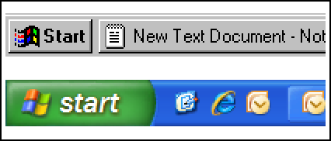
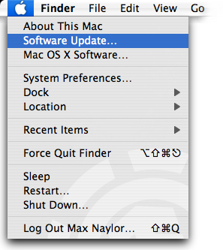
Fitt’s Law in Windows vs Mac OS
Windows 95: Missed by a pixel
Windows XP: Good to the last drop
The Apple menu in Mac OS X v10.4 Tiger.
Source: Jensen Harris, An Office User Interface Blog : Giving You Fitts. Microsoft, 2007; Apple

Slide 20
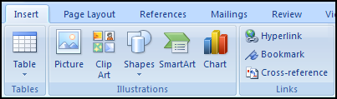
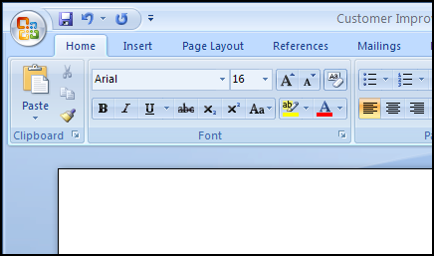
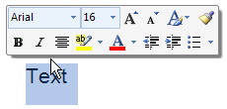
Fitt’s Law in Microsoft Office 2007
Larger, labeled controls can be clicked more quickly
Magic Corner: Office Button in the upper-left corner
Mini Toolbar: Close to the cursor
Source: Jensen Harris, An Office User Interface Blog : Giving You Fitts. Microsoft, 2007.

Slide 21
Principles of Operation (cont.)
Power Law of Practice
  task time on the nth trial follows a power law
    T_{n} = T₁ n^{-a} + c, where a = .4, c = limiting constant
    i.e., you get faster the more times you do it!
    applies to skilled behavior (sensory & motor)
    does not apply to knowledge acquisition or quality
Source: Landay, James. “Human Abilities”. CS160 UC Berkeley.

Slide 22
Implications for mobile design
Nokia N95 interface designs?
iPhone?
What might happen to mobile device “inputs” in the future?

Slide 23
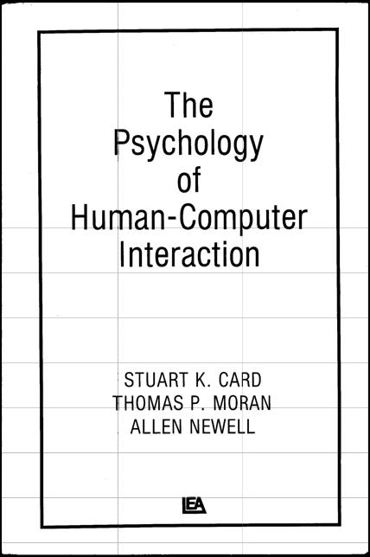
CMN
Source: Card, Stu. Lecture on Human Information Interaction. Stanford, 2007.

Slide 24
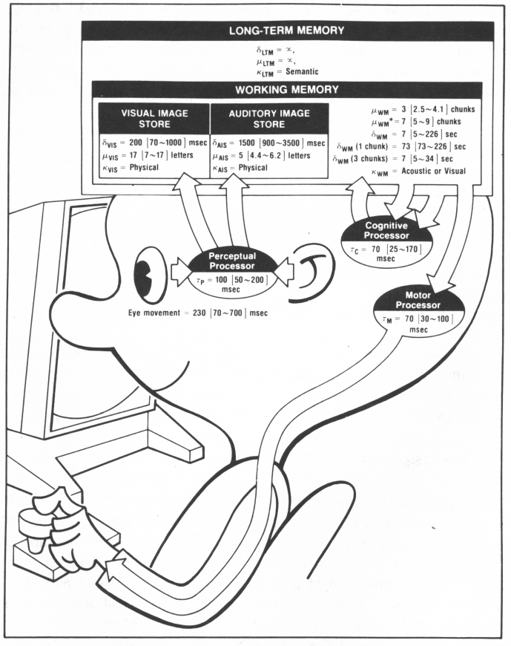
MODEL HUMAN PROCESSOR
Processors and Memories applied to human
Used for routine cognitive skill [and learning and forgetting!]
Source: Card, Stu. Lecture on Human Information Interaction. Stanford, 2007.

Slide 25
MHP
Source: Card, Stu. Lecture on Human Information Interaction. Stanford, 2007.

Slide 26
Stage Theory
maintenance
rehearsal
Sensory Image Store
Working Memory
Long Term Memory
decay
decay,
displacement
decay?
interference?
chunking / elaboration
Source: Landay, James. “Human Abilities”. CS160 UC Berkeley.

Slide 27
Stage Theory
Working memory is small
  temporary storage
    decay
    displacement
Maintenance rehearsal
  rote repetition
  not enough to learn information well
Answer to problem is organization
Source: Landay, James. “Human Abilities”. CS160 UC Berkeley.

Slide 28
MHP Principles of Operation
Recognize-Act Cycle of the CP
  on each cycle contents in WM initiate actions associatively linked to them in LTM
  actions modify the contents of WM
Discrimination Principle
  retrieval is determined by candidates that exist in memory relative to retrieval cues
  interference by strongly activated chunks
Source: Landay, James. “Human Abilities”. CS160 UC Berkeley.

Slide 29
Principles of Operation (cont.)
Variable Cog. Processor Rate Principle
  CP cycle time T_{c} is shorter when greater effort
  induced by increased task demands/information
  decreases with practice
Source: Landay, James. “Human Abilities”. CS160 UC Berkeley.

Slide 30
Implications for Designing from MHP
Recognition over recall
Relate interface to existing material
Recode design in different ways
Organize and link information
Use visual imagery and auditory enhancements
Source: Landay, James. “Human Abilities”. CS160 UC Berkeley.

Slide 31
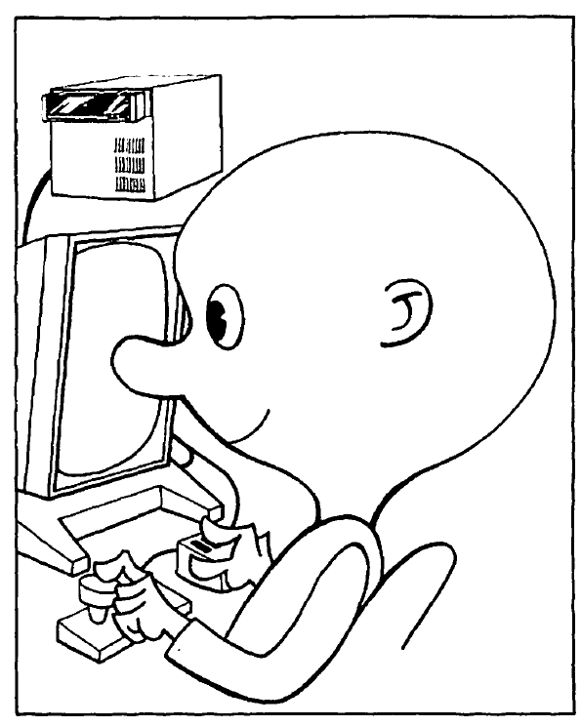
TASK ANALYSIS: GOMS
(GOALS, OPERATORS, METHODS,
SELECTION RULES)
task analysis
GOAL: EDIT-MANUSCRIPT • repeat until done
  GOAL: EDIT-UNIT-TASK
    GOAL: ACQUIRE-UNIT-TASK • if not remembered
      GET-NEXT-PAGE • if at end of page
      GET-NEXT-TASK • if an edit task found
    GOAL: EXECUTE-UNIT-TASK
      GOAL: LOCATE-LINE • if task not on line
        [select : USE-QS-METHOD
        USE-LF-METHOD]
      GOAL: MODIFY-TEXT
        [select USE-S-COMMAND
        USE-M-COMMAND]
Source: Card, Stu. Lecture on Human Information Interaction. Stanford, 2007.

Slide 32
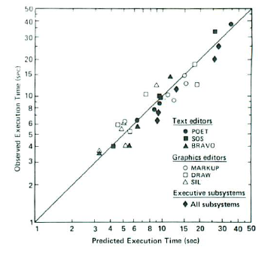
PREDICTS TIME WITHIN ABOUT 20%
Source: Card, Stu. Lecture on Human Information Interaction. Stanford, 2007.

Slide 33
GOMS Example: for Mac Finder
Method for goal: delete a file.
Step 1. Accomplish goal: drag file to trash.
Step 2. Return with goal accomplished.
Method for goal: move a file.
Step 1. Accomplish goal: drag file to destination.
Step 2. Return with goal accomplished.
Method for goal: delete a directory.
Step 1. Accomplish goal: drag directory to trash.
Step 2. Return with goal accomplished.
Method for goal: move a directory.
Step 1. Accomplish goal: drag directory to destination.
Step 2. Return with goal accomplished.
Method for goal: drag item to destination.
Step 1. Locate icon for item on screen.
Step 2. Move cursor to item icon location.
Step 3. Hold mouse button down.
Step 4. Locate destination icon on screen.
Step 5. Move cursor to destination icon.
Step 6. Verify that destination icon is reverse-video.
Step 7. Release mouse button.
Step 8. Return with goal accomplished.
Source: Abowd, Gregory. CS 4753. Human Factors in Software Development. Georgia Tech.

Slide 34
Comparison: for DOS
Method for goal: delete a file.
Step 1. Recall that command verb is "ERASE".
Step 2. Think of directory name and file name and retain as first filespec.
Step 4. Accomplish goal: enter and execute a command.
Step 6. Return with goal accomplished.
Method for goal: move a file.
Step 1. Accomplish goal: copy a file.
Step 2. Accomplish goal: delete a file.
Step 3. Return with goal accomplished.
Method for goal: copy a file.
Step 1. Recall that command verb is "COPY".
Step 2. Think of source directory name and file name and retain as first filespec.
Step 3. Think of destination directory name and file name and retain as second filespec.
Step 4. Accomplish goal: enter and execute a command.
Step 5. Return with goal accomplished.
Method for goal: delete a directory.
Step 1. Accomplish goal: delete all files in the directory.
Step 2. Accomplish goal: remove a directory.
Step 3. Return with goal accomplished.
Method for goal: delete all files in a directory.
Step 1. Recall that command verb is "ERASE".
Step 2. Think of directory name.
Step 3. Retain directory name and "*.*" as first filespec.
Step 4. Accomplish goal: enter and execute a command.
Step 5. Return with goal accomplished.
Method for goal: remove a directory
Step 1. Recall that command verb is "RMDIR".
Step 2. Think of directory name and retain as first filespec.
Step 3. Accomplish goal: enter and execute a command.
Step 4. Return with goal accomplished.
Method for goal: move a directory.
Step 1. Accomplish goal: copy a directory.
Step 2. Accomplish goal: delete a directory.
Step 3. Return with goal accomplished.
Method for goal: copy a directory.
Step 1. Accomplish goal: create a directory.
Step 2. Accomplish goal: copy all the files in a directory.
Step 3. Return with goal accomplished.
Method for goal: create a directory.
Step 1. Recall that command verb is "MKDIR".
Step 2. Think of directory name and retain as first filespec.
Step 3. Accomplish goal: enter and execute a command.
Step 4. Return with goal accomplished.
Method for goal: copy all files in a directory.
Step 1. Recall that command verb is "COPY".
Step 2. Think of directory name.
Step 3. Retain directory name and "*.*" as first filespec.
Step 4. Think of destination directory name.
Step 5. Retain destination directory name and "*.*" as second filespec.
Step 6. Accomplish goal: enter and execute a command.
Step 7. Return with goal accomplished.
Method for goal: enter and execute a command.
Entered with strings for a command verb and one or two filespecs.
Step 1. Type command verb.
Step 2. Accomplish goal: enter first filespec.
Step 3. Decide: If no second filespec, goto 5.
Step 4. Accomplish goal: enter second filespec.
Step 5. Verify command.
Step 6. Type "<CR>".
Step 7. Return with goal accomplished.
Method for goal: enter a filespec.
Entered with directory name and file name strings.
Step 1. Type space.
Step 2. Decide: If no directory name, goto 5.
Step 3. Type "\".
Step 4. Type directory name.
Step 5. Decide: If no file name, return with goal accomplished.
Step 6. Type file name.
Step 7. Return with goal accomplished.
Source: Abowd, Gregory. CS 4753. Human Factors in Software Development. Georgia Tech.

Slide 35
Comparison
Mac Finder: only 3 methods to accomplish these user goals, involving a total of only 18 steps.
DOS requires 12 methods with a total of 68 steps.
Consistency in Mac Finder
A major value of a GOMS model is its ability to characterize, and even quantify, this property of method consistency.
Source: Abowd, Gregory. CS 4753. Human Factors in Software Development. Georgia Tech.

Slide 36
Implications for interface design
GOMS not often used formally
But thinking through consistency of sub-tasks very useful!
Good for comparing different systems

Slide 37
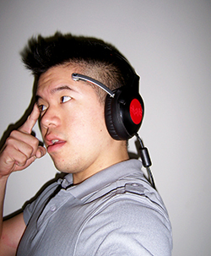
Eye to the Future: Brain Computer Interfaces
Your brain might be your next videogame controller.
http://www.youtube.com/watch?v=hQWBfCg91CU
NeuroSky
Source: NeuroSky, “Direct Brain-to-Game Interface Worries Scientists”, Wired Magazine, 2007

Slide 38
Eye to the Future: Brain Computer Interfaces WARNING!
… the devices sometimes force users to slow down their brain waves. Afterward, users have reported trouble focusing their attention.
NeuroSky
Source: NeuroSky, “Direct Brain-to-Game Interface Worries Scientists”, Wired Magazine, 2007

